Slide 1
Lecture: Edge Detection
Juan Carlos Niebles and Ranjay Krishna
Stanford Vision and Learning Lab
Notes:
Edges are significant local changes in the image and are important features for analyzing images.Edges typically occur on the boundary between two different regions in an image.

Slide 2
What we will learn today
Edge detection
Image Gradients
A simple edge detector
Sobel edge detector

Slide 3


Slide 4
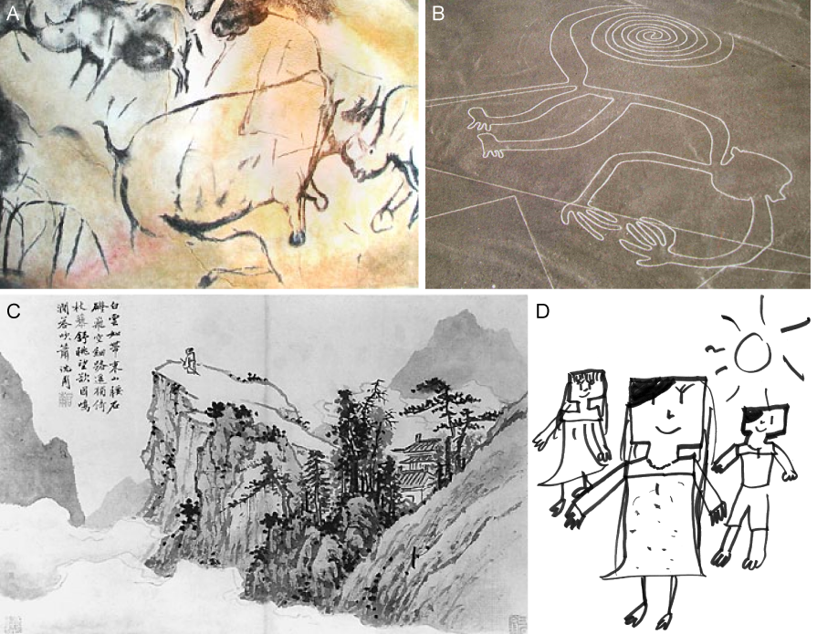
Cave painting at Chauvet, France, about 30,000 B.C.;
Aerial photograph of the picture of a monkey as part of the Nazca Lines geoglyphs, Peru, about 700 – 200 B.C.;
Shen Zhou (1427-1509 A.D.): Poet on a mountain top, ink on paper, China;
Line drawing by 7-year old I. Lleras (2010 A.D.).
Notes:
Edges are significant local changes in the image and are important features for analyzing images. Edges typically occur on the boundary between two different regions in an image.

Slide 5
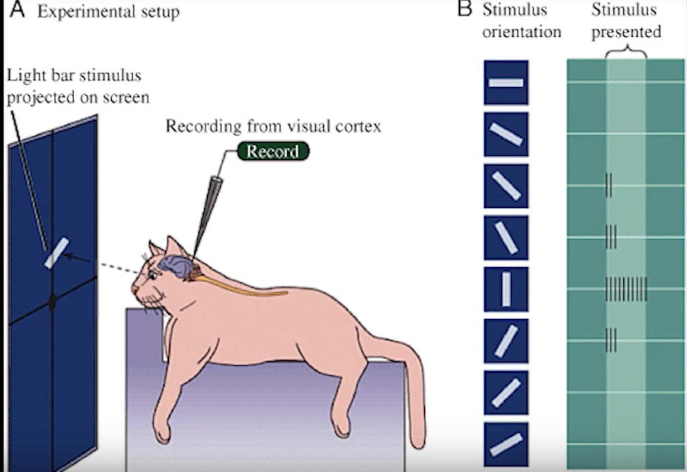
Hubel & Wiesel, 1960s
Notes:
Hubel和Wiesel在猫视觉皮层实验中，首次观察到视觉初级皮层的神经元对移动的边缘刺激敏感，并定义了简单和复杂细胞，发现了视功能柱结构。此项工作为视觉神经研究奠定了重要的基础，两人在1981年共享了诺贝尔生理学或医学奖，以表彰他们在“视觉系统信息加工”的重要贡献。

Slide 6
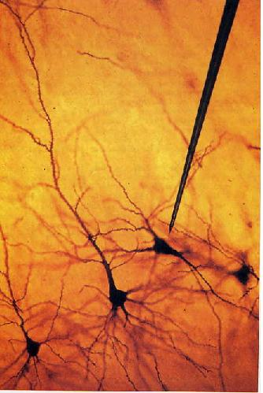
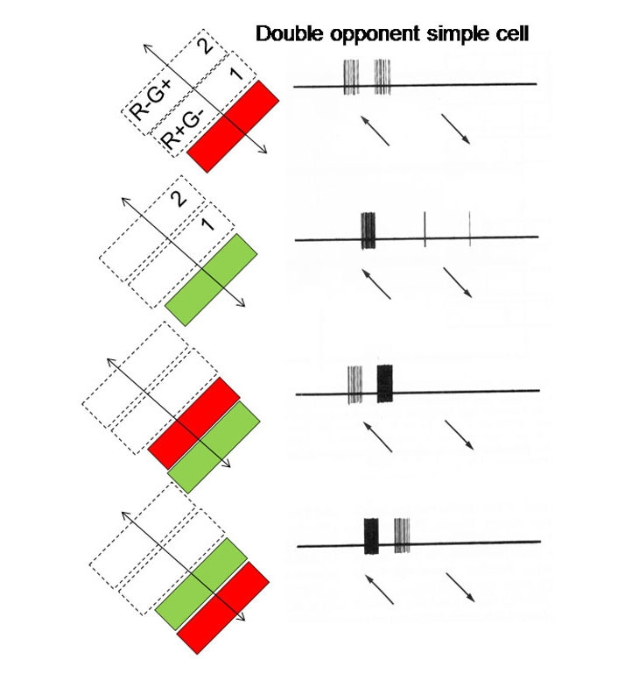
We know edges are special from human (mammalian) vision studies
Hubel & Wiesel, 1960s
Notes:
Hubel和Wiesel首先试图让视觉皮层中的神经元对传统的视觉刺激如点做出反应。他们几乎没有成功。不管圆圈的大小和位置，它们的神经元都不在乎。后来有一天，当他们从另一个顽固沉默的神经元录音时，当他们改变用来呈现刺激的投影幻灯片时，神经元突然开始疯狂地放电。原来，手机对幻灯片边缘有反应。就在那时，hubel和wiesel发现有专门用来检测线条的细胞，这是视觉世界的一个基本特征。

Slide 7
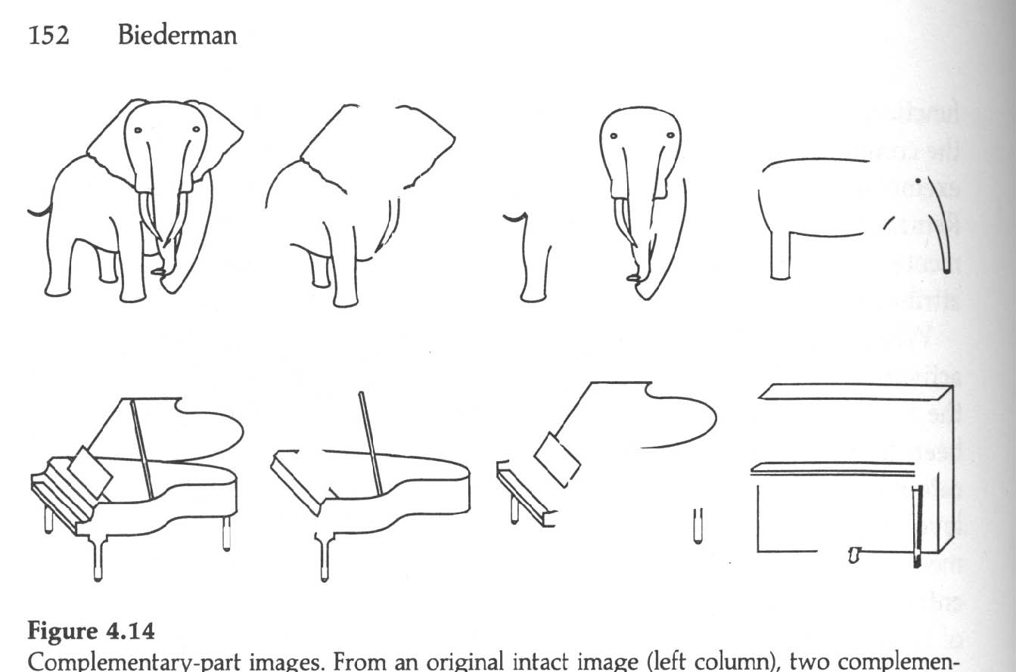
We know edges are special from human (mammalian) vision studies
Notes:
Part-deleted complementary images were created by deleting approximately half the components from each image. In this way each complementary images contained about 50% of the original contour. Put together the two complementary images would reproduce the intact line drawing. A same name, different exemplar image was also created (right column) to assess non-visual priming in a naming experiment (Biederman and Cooper, 1991).
Performance of human subjects on identical and complement images was strikingly different indicating that complementary part-deleted image pairs were not equivalent to each other for human observers. In fact, the complement image was perceived as if it were a different exemplar of the same category.

Slide 8
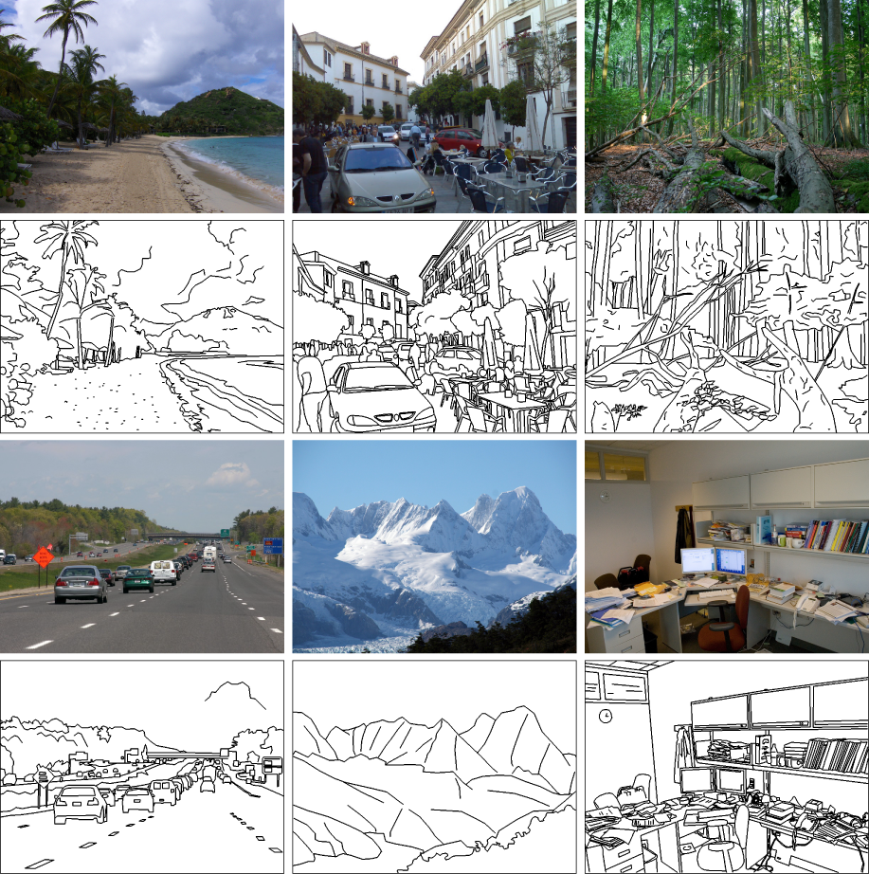
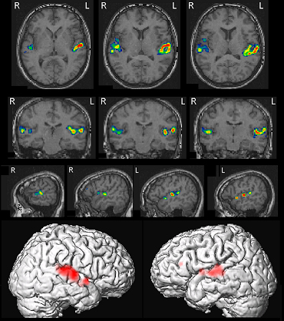
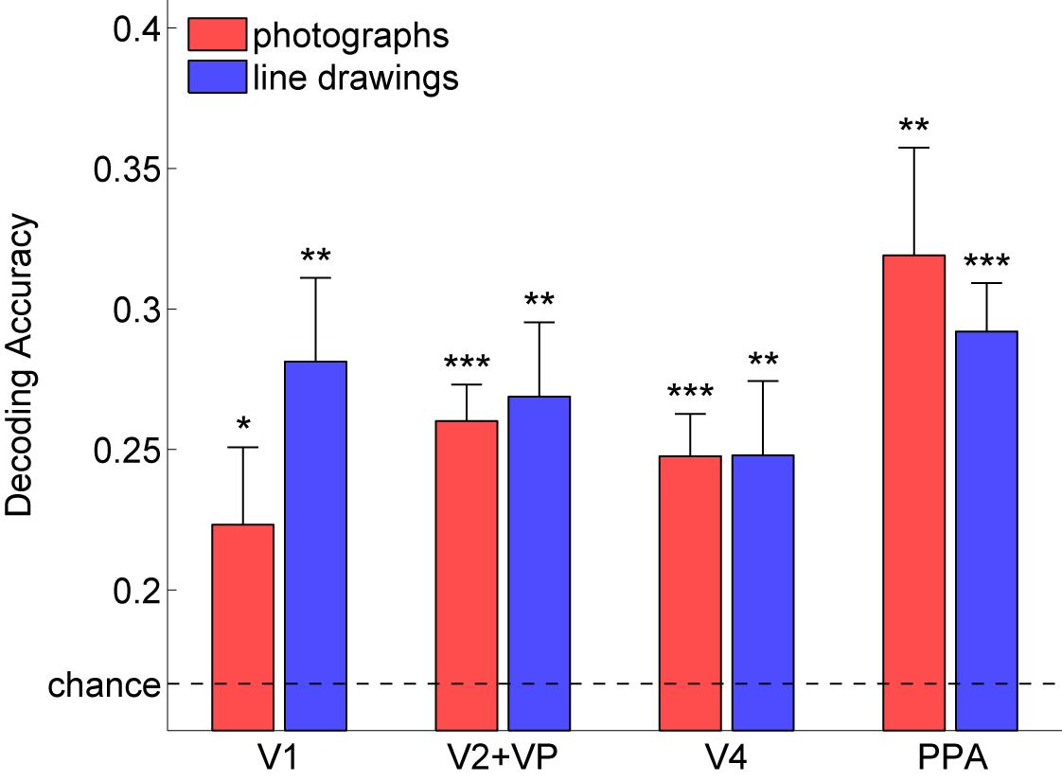
Walther, Chai, Caddigan, Beck & Fei-Fei, PNAS, 2011
Notes:
They collected fMRI data while participants viewed photographs and line drawings of beaches, city streets, forests, highways, mountains, and offices. Despite the marked difference in scene statistics, we were able to decode scene category from fMRI data for line drawings just as well as from activity for color photographs,
global scene structure, which is preserved in line drawings, plays an integral part in representing scene categories

Slide 9
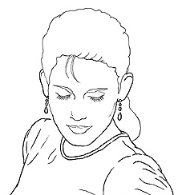
Edge detection
Goal: Identify sudden changes (discontinuities) in an image
Intuitively, most semantic and shape information from the image can be encoded in the edges
More compact than pixels
Ideal: artist’s line drawing (but artist is also using object-level knowledge)
Source: D. Lowe

Slide 10
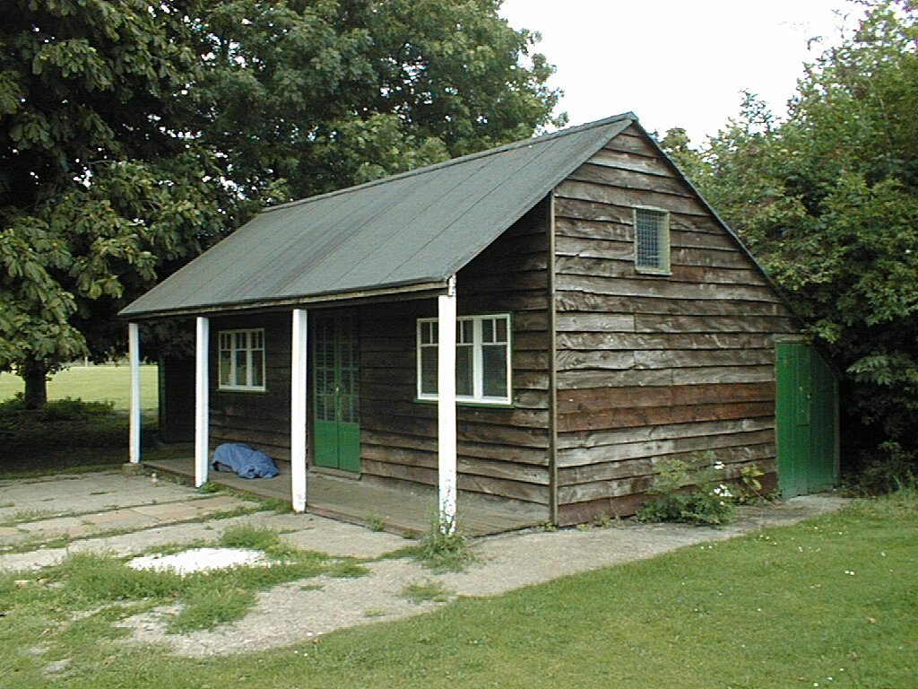
Why do we care about edges?
Extract information, recognize objects
Recover geometry and viewpoint
Vertical vanishing
point
(at infinity)
Vanishing
line
Vanishing
point
Vanishing
point
Source: J. Hayes

Slide 11
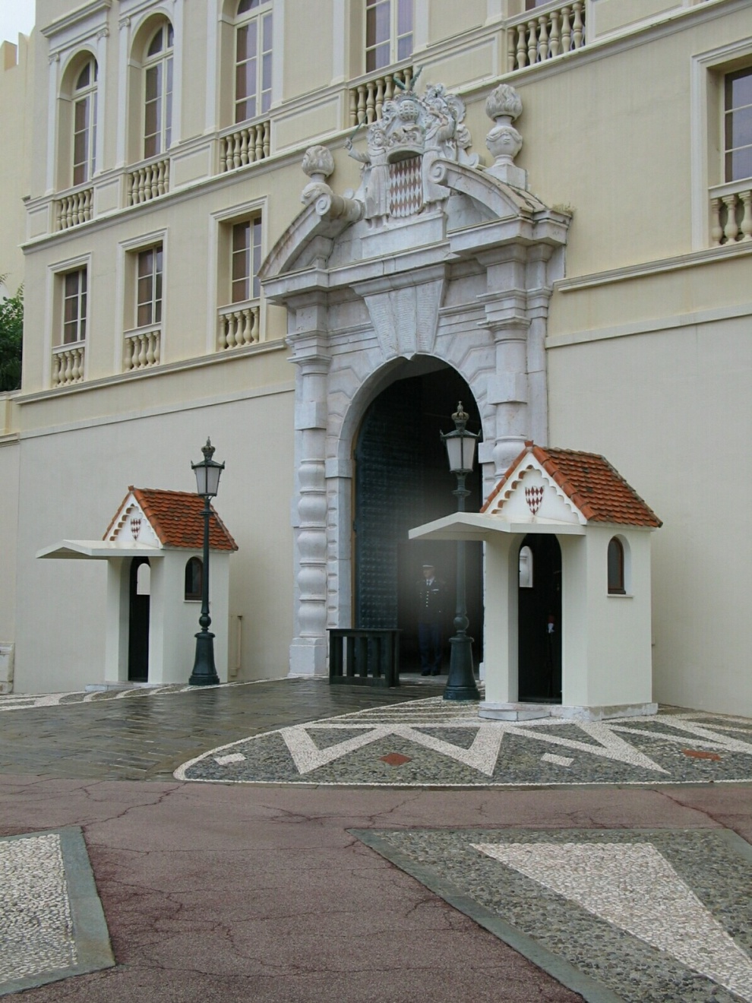
Origins of edges
surface normal discontinuity
depth discontinuity
surface color discontinuity
illumination discontinuity
Source: D. Hoiem

Slide 12
Closeup of edges
Surface normal discontinuity
Source: D. Hoiem

Slide 13
Closeup of edges
Depth discontinuity
Source: D. Hoiem

Slide 14
Closeup of edges
Surface color discontinuity
Source: D. Hoiem

Slide 15
What we will learn today
Edge detection
Image Gradients
A simple edge detector
Sobel edge detector

Slide 16
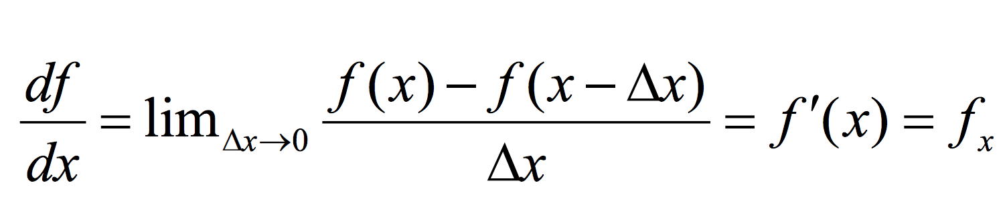
Derivatives in 1D

Slide 17
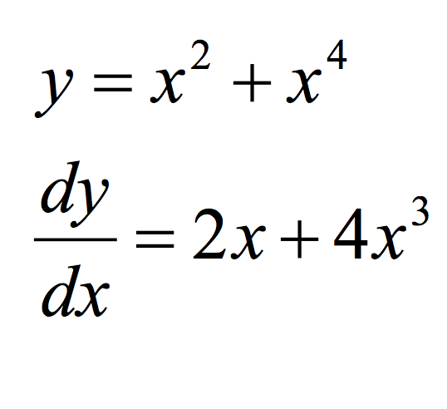
Derivatives in 1D - example

Slide 18
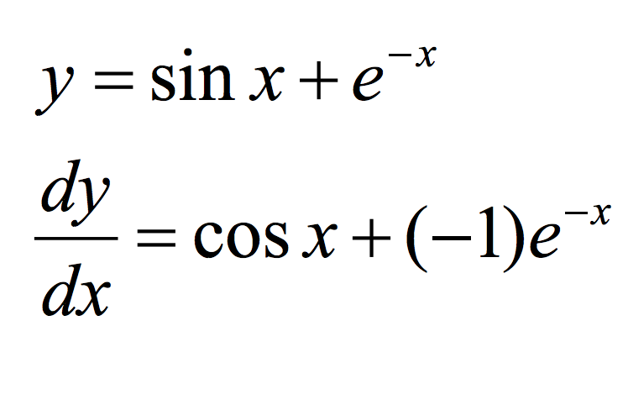
Derivatives in 1D - example
Slide credit: Dr Mubarak

Slide 19
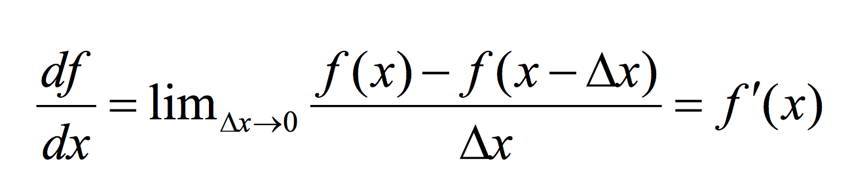
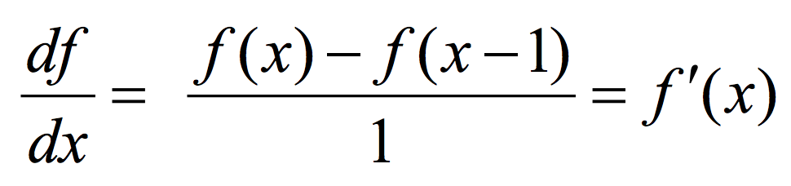
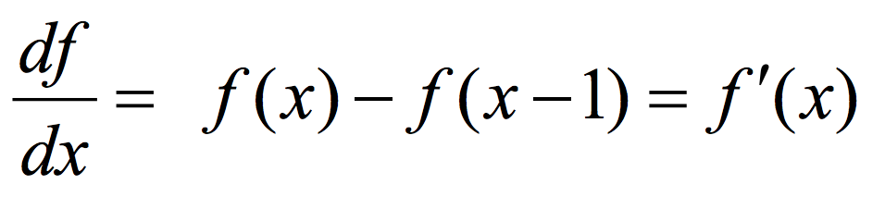
Discrete Derivative in 1D

Slide 20
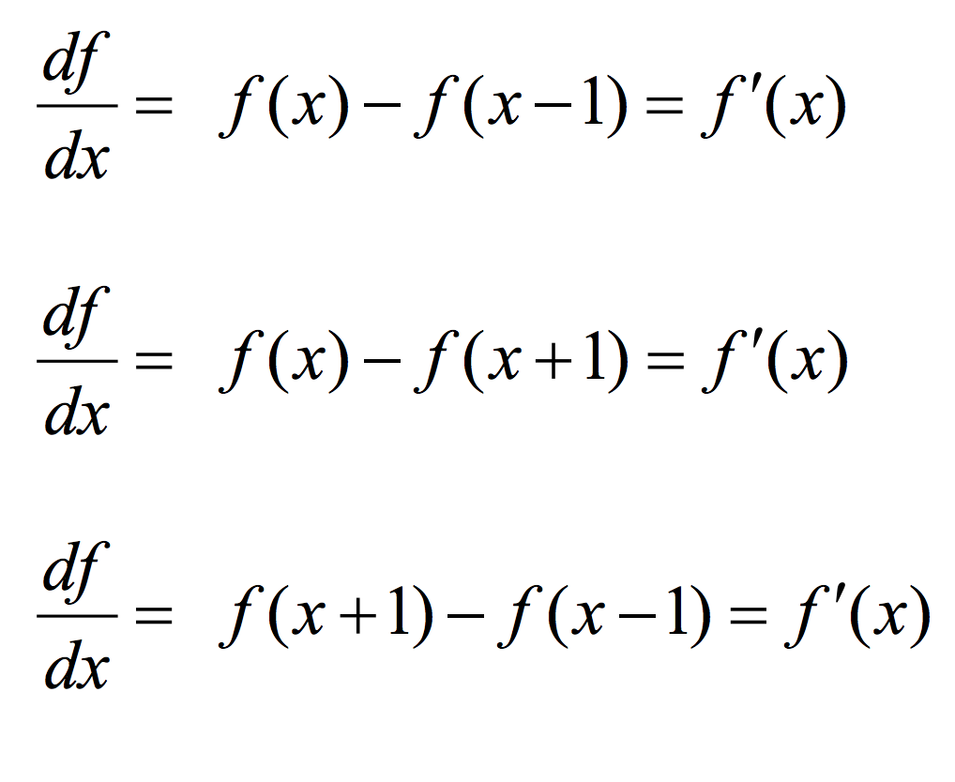
Types of Discrete derivative in 1D
Backward
Forward
Central

Slide 21
1D discrete derivate filters
Backward filter: [0 1 -1]
Forward: [-1 1 0]
Central: [ 1 0 -1]

Slide 22
1D discrete derivate filters
Backward filter: [0 1 -1]

Slide 23
1D discrete derivate filters
Backward filter: [0 1 -1]
Forward: [-1 1 0]

Slide 24
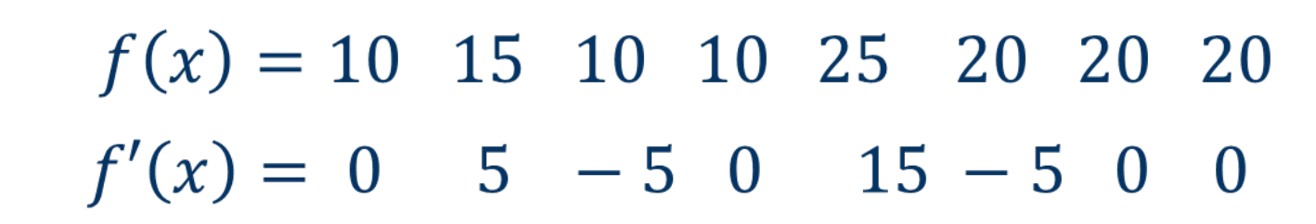
1D discrete derivate example

Slide 25
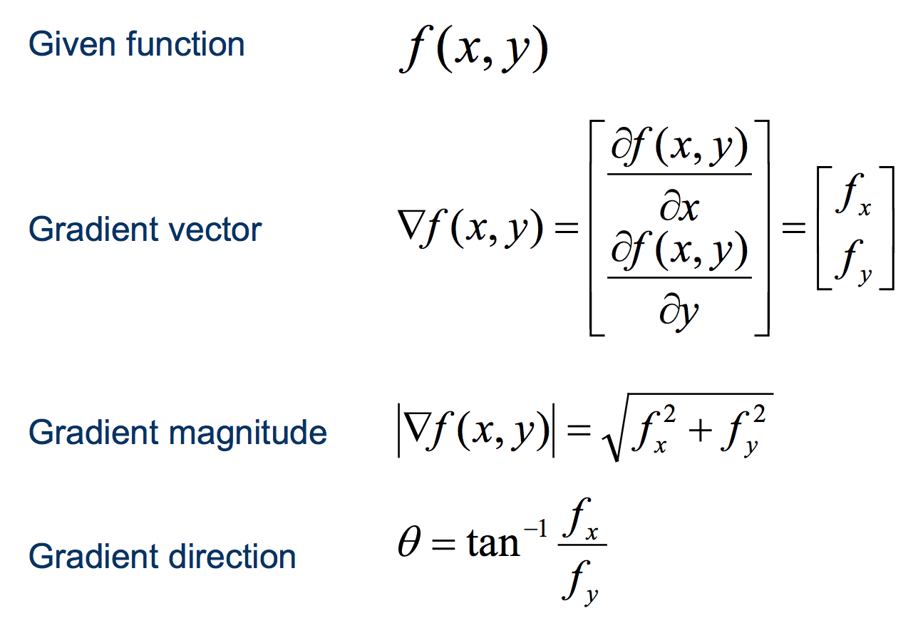
Discrete derivate in 2D

Slide 26
Discrete derivate in 2D

Slide 27
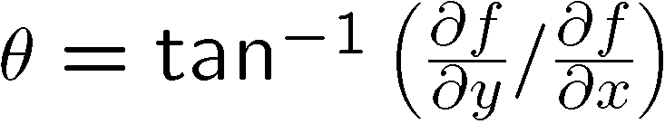
Discrete derivate in 2D

Slide 28
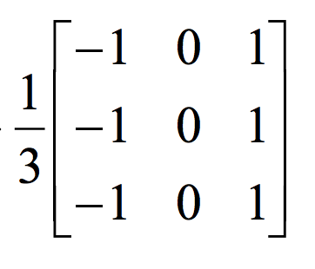
2D discrete derivative filters
What does this filter do?

Slide 29
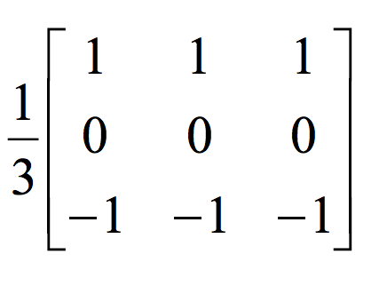
2D discrete derivative filters
What about this filter?

Slide 30
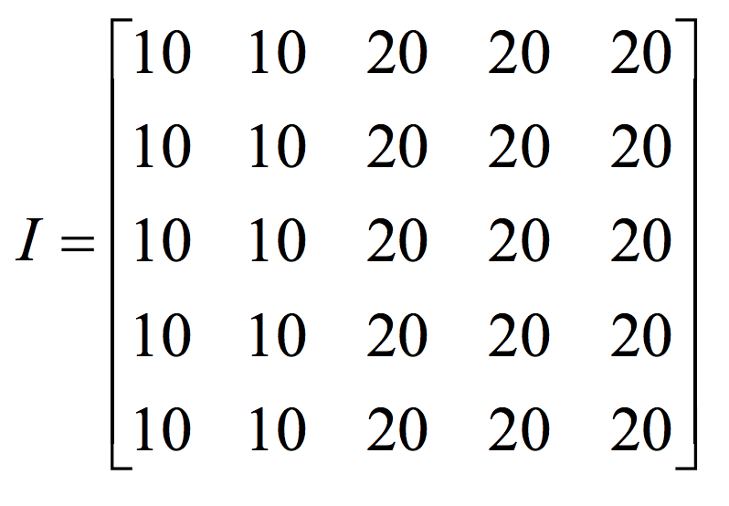
2D discrete derivative - example

Slide 31
2D discrete derivative - example
What happens when we apply this filter?

Slide 32
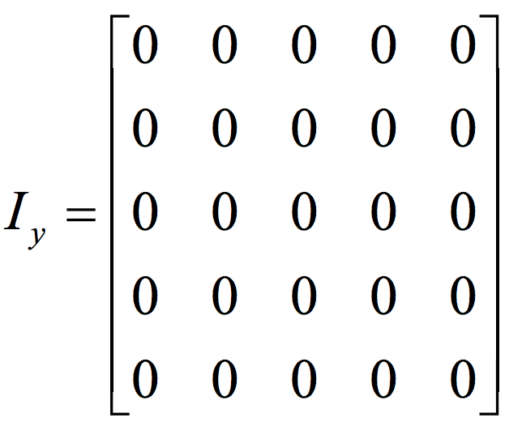
2D discrete derivative - example
What happens when we apply this filter?

Slide 33
2D discrete derivative - example
Now let’s try the other filter!

Slide 34
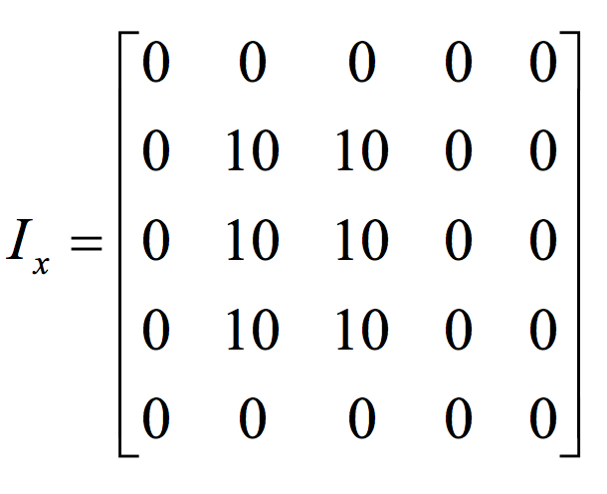
2D discrete derivative - example
What happens when we apply this filter?

Slide 35
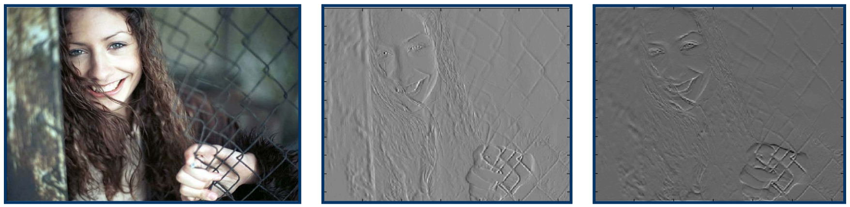
3x3 image gradient filters

Slide 36
What we will learn today
Edge detection
Image Gradients
A simple edge detector
Sobel edge detector

Slide 37

Characterizing edges
An edge is a place of rapid change in the image intensity function
intensity function (along horizontal scanline)
image
first derivative
edges correspond to extrema of derivative

Slide 38

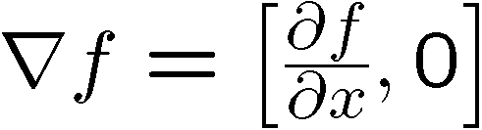

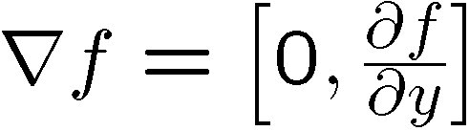
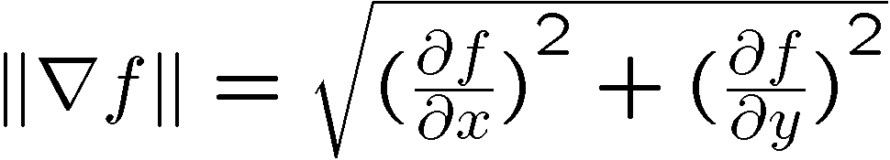
Image gradient
The gradient of an image:
The gradient vector points in the direction of most rapid increase in intensity
The gradient direction is given by
how does this relate to the direction of the edge?
The edge strength is given by the gradient magnitude
Source: Steve Seitz
Notes:
give definition of partial derivative: lim h->0 [f(x+h,y) – f(x,y)]/h

Slide 39
Finite differences: example
Original
Image
Gradient magnitude
x-direction
y-direction
Which one is the gradient in the x-direction? How about y-direction?

Slide 40
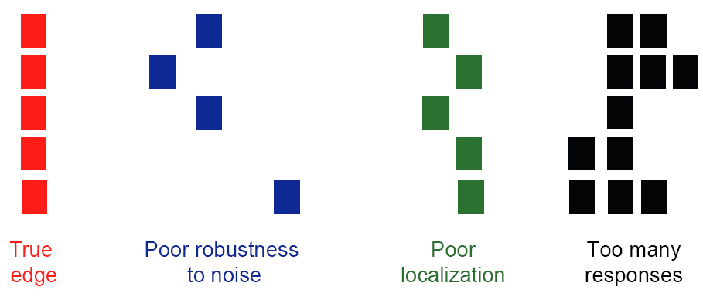
Designing an edge detector
Criteria for an “optimal” edge detector:
Good detection: the optimal detector must minimize the probability of false positives (detecting spurious edges caused by noise), as well as that of false negatives (missing real edges)

Slide 41
Designing an edge detector
Criteria for an “optimal” edge detector:
Good detection: the optimal detector must minimize the probability of false positives (detecting spurious edges caused by noise), as well as that of false negatives (missing real edges)
Good localization: the edges detected must be as close as possible to the true edges

Slide 42
Designing an edge detector
Criteria for an “optimal” edge detector:
Good detection: the optimal detector must minimize the probability of false positives (detecting spurious edges caused by noise), as well as that of false negatives (missing real edges)
Good localization: the edges detected must be as close as possible to the true edges
Single response: the detector must return one point only for each true edge point; that is, minimize the number of local maxima around the true edge

Slide 43
What we will learn today
Edge detection
Image Gradients
A simple edge detector
Sobel Edge detector

Slide 44
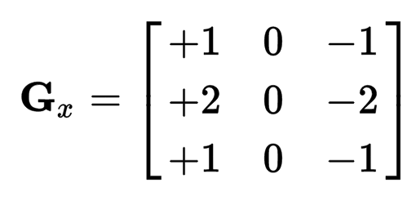
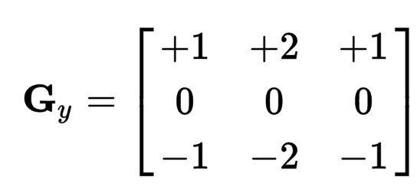
Sobel Operator
uses two 3×3 kernels which are convolved with the original image to calculate approximations of the derivatives
one for horizontal changes, and one for vertical

Slide 45
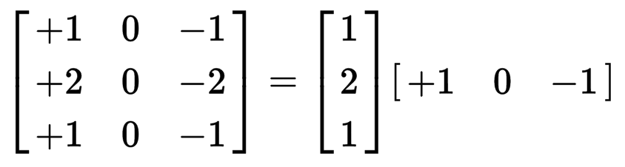
Sobel Operation
Smoothing + differentiation
Gaussian smoothing
differentiation

Slide 46
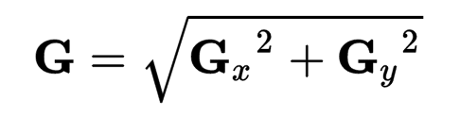
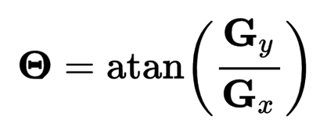
Sobel Operation
Magnitude:
Angle or direction of the gradient:
Notes:
Gradient is a vector!

Slide 47
Sobel Filter example
Notes:
We can threshold the gradient map, and choose edges to be the pixels above T.

Slide 48
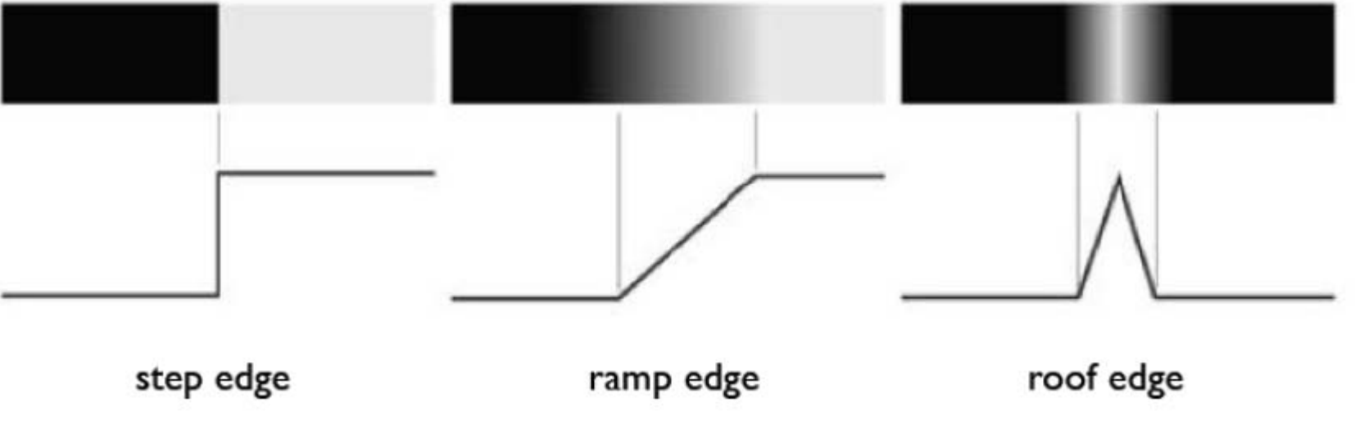
Sobel Filter Problems
Poor Localization (Trigger response in multiple adjacent pixels)
Thresholding value favors certain directions over others
Can miss oblique edges more than horizontal or vertical edges
False negatives
Notes:
Thresholding is….

